Slide 1

Day 3
SNA and R

Slide 2
Awesome Network Analysis Resources
https://github.com/briatte/awesome-network-analysis#datasets

Slide 3
Preliminaries (Redux)
What is a graph?
A set of vertices with lines between pairs of vertices
What is a network
A network is a graph where we add attributes to make the graph more sensible
Graphs or networks have three main components important for visualization
Vertices and nodes
Lines
Layout
Notes:
The first fundamental concept is what is a graph? A network is a special kind of graph.
A graph is
A network is a
We need to think about vertices and nodes, lines and layout

Slide 4
Networks can vary through
nodes
edges
layouts

Slide 5
Node Types: Unimodal
All entitles are the same type
Student 1
Student 2
Student 3
Example: students in a university

Slide 6
Multimodal (“bipartite network”) Entitles are of different types
Student 1
Anna
Student 2
Different Type
Notes:
Students at a university are bound to professors
Profe represent one type of node, students are a different mode

Slide 7
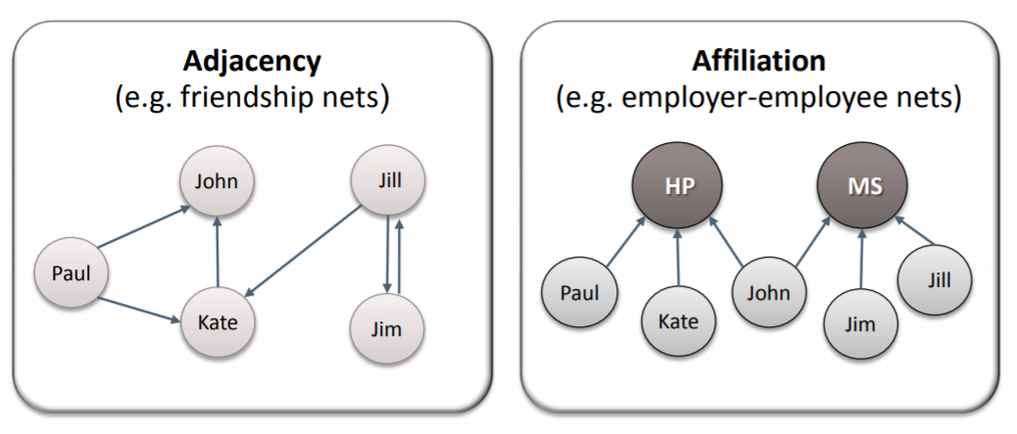
One and Two- Node Networks

Slide 8
Undirected – lines are called “edges”
Student 1
Anna
Student 2
EDGE
EDGE
Directionality is not a salient feature of the network
Notes:
The link between the two entitles would be referred to as an edge

Slide 9
Directed – lines are called “arcs”
Student 1
Anna
Student 2
ARC
ARC
Notes:
The reciprocity of the line (link or tie) is an important feature of the network

Slide 10
Arc Edges
Weighted
Unweighted
(a.k.a. dichotomous or binary)
Notes:
Weighted versus unweighted
An unweighted network (“dichotomous or binary”)— edge takes one of two values – there can be no edge which is a 0 or an edge can be present = 1
Weighted network edge takes infinite values – more info and gives a sense of how strong the tie is
Recall a third edge type – loop – person nominates themselves

Slide 11
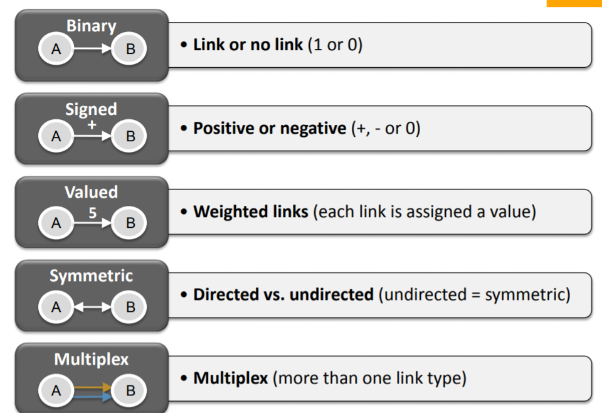
Link types
Notes:
Networks can differ in terms of their links or lines

Slide 12
Aesthetics: Layout
Notes:
Hierarchcial or spring layout – no clear hierarchical structure, things are more centralized, no clear rank order

Slide 13
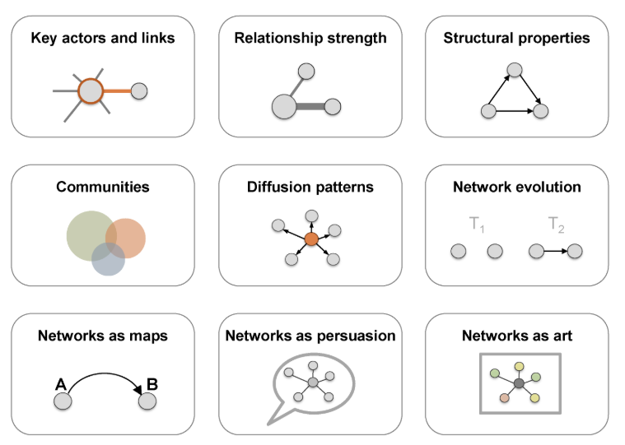
Introduction: network visualization
The main concern in designing a network visualization is the purpose it has to serve. What are the structural properties that we want to highlight? What are the key concerns we want to address?

Slide 14
Network representation formats
Network maps
Statistical charts
Heat maps
Sankey diagrams
Spatial representations

Slide 15
Visualization Aesthetics
In network maps, as in other visualization formats, we have several key elements that control the outcome. The major ones are color, size, shape, and position
Modern graph layouts are optimized for speed and aesthetics. In particular, they seek to minimize overlaps and edge crossing, and ensure similar edge length across the graph.

Slide 16
Working with Network Data

Slide 17
Data Structures
Two main data structures when getting data into R
1. Adjacency matrix
2. Edgelist

Slide 18
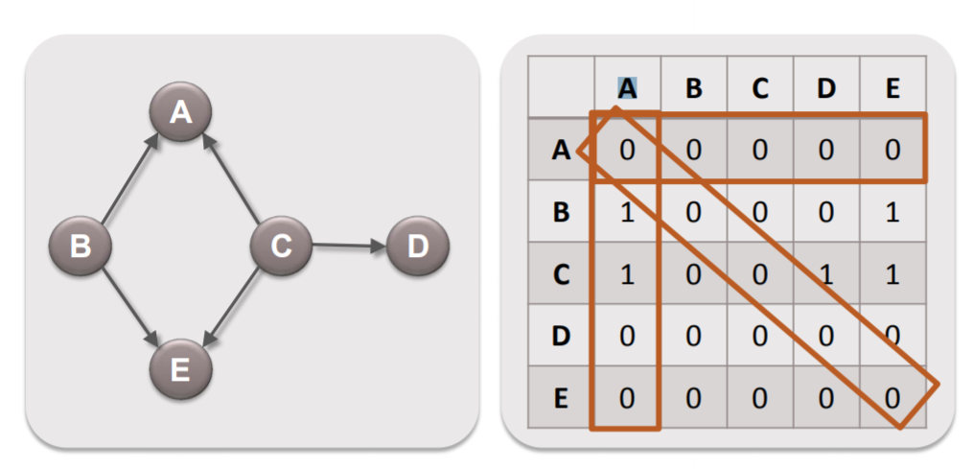
Adjacency Matrix Representation: Directed
Notes:
—shows how adjacent one node is to another through a value (e.g. 0s and 1s)
Advantage – allows us to do mathematical manipulations directly to the network so we can transform the network- when we transform the network as we are visualizing it is calculating it as a matrix
Disadvantage: not intuitive when collecting data, they are “expensive” data structures – more efficient human friendly representation and then let computer turn it into an adjacency network

Slide 19
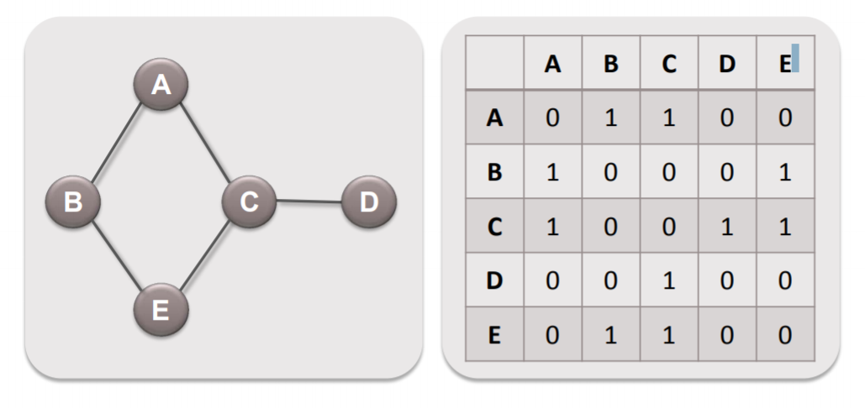
Adjacency Matrix representation: Symmetric

Slide 20
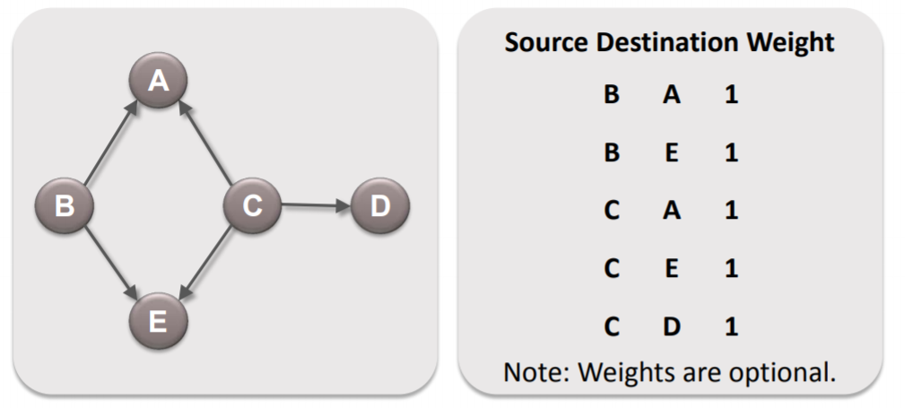
Edge List Data Format
An edgelist has three components
A sender who is initiating time
A target- receiving tie
A weight – strength of that tie
Notes:
R will turn this format into an adjacency matrix for us…

Slide 21
Some strategies for network data collection
Ego Networks
Can use standard sampling techniques (e.g. random sample)
Each respondent describes their own relationships (name generators).
Complete Networks
Each respondent reports their own relationships within the network.
Could use a roster that people use to identify contacts
Cognitive Social Structures
Ask not only for a person’s own relationships, but also for perceived relationships between other people in your population.
Snowball Sampling
Individuals included in the sample identify contacts (friends, sexual partners, etc.) who are added to the study at the next step
Secondary Data
Social media

Slide 22
SNA in R
Three major packages supporting network analysis
Igraph
Statnet
SNA
Download all packages using the standard installer through RStudio

Slide 23
Food for thought
In thinking about your research goals, consider the following the questions:
what is the central problem of your research and why it is worth investigating,
what phenomenon you are studying, in which context, and what key question(s) you have about the phenomenon, and
why SNA is potentially fruitful based on your current understanding.
SNA can be conceptualized as a variable for another type of analysis or can be used in and of itself to examine structural relationships/attributes

Slide 24
Follow the steps in the R markdown file with the file that is located here

Slide 25
The Research Question:
Do academic collaborations create new partnerships for faculty and students?

Slide 26
Using:
Dataset 1: A Colleague network “who do colleagues communicate with”?
Dataset 2: A Student network: Who do students work with?

